Slide 1
School of Geography and Geology
McMaster University
WELCOME TO
Introduction
to Spatial Statistics
(510-654)
Diploma in Spatial Analysis and GIS Certificate in GIS
September – December, 2003

Slide 2
Who am I?
Antonio Páez
Education:
  Civil Engineering (ITESM, Mexico; Dec. 93)
  M.Sc. Information (Tohoku, Japan; Sept. 97)
  Ph.D. Engineering (Tohoku, Japan; Sept. 00)
Work:
  CNEAS (Tohoku, Japan)
  School of Geography and Geology (Jul. 02)

Slide 3
What do I do?
Antonio Páez
Teaching:
  Spatial statistics (This course)
  Locational analysis (GEO 2HA3)
  Land use and transportation (GEO 4H03)
Research:
  Transportation and land use analysis
  Spatial statistics

Slide 4
Where can you find me?
Antonio Páez
Contact information:
  Burke Science Building 337/A
  E-mail: paezha@mcmaster.ca
  Telephone: 905-525-9140 ext. 26099
  Office hours: M, F 8:30 – 10:00 A.M.

Slide 5
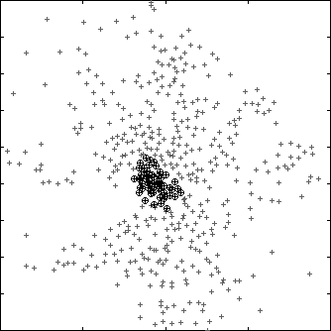
Real Estate Transactions
Sendai, Japan (1996)
Observations
20
18
16
14
12
10
8
6
4
2
Northing (km)
CBD Location
Non-CBD Location
0 5 10 15 20
Easting (km)

Slide 6
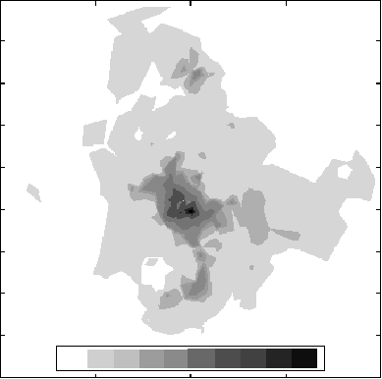
Land prices in Sendai, Japan
20
18
16
14
12
10
8
6
4
2
Northing (km)
0 100 200 300 400 500 1000 2000 3000 4000 5000
0 5 10 15 20
Easting (km)

Slide 7
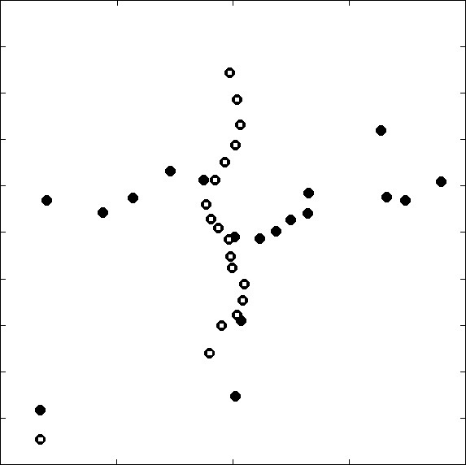
Transportation Systems in Sendai
Subway and Train Stations
20
18
16
14
12
10
8
6
4
2
Izumi
Iwakiri
Kita Sendai
Ochiai
Northing (km)
Sendai
Nagamachi
Train Station
Minami Sendai
Subway Station
0 5 10 15 20
Easting (km)

Slide 8
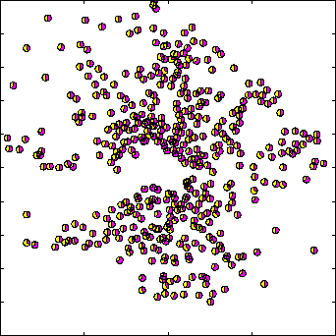
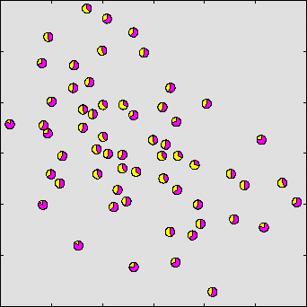
Land prices in Sendai, Japan
Non-CBD Locations
CBD Locations
p_{i} = P_{Ei}
20
18
16
14
12
10
8
6
4
2
p_{i} > P_{Ei}
11
10.5
10
9.5
9
p_{i} < P_{Ei}
Northing (km)
0 5 10 15 20
8 8.5 9 9. 5 10 10.5 11
Easting (km)
Easting (km)

Slide 9
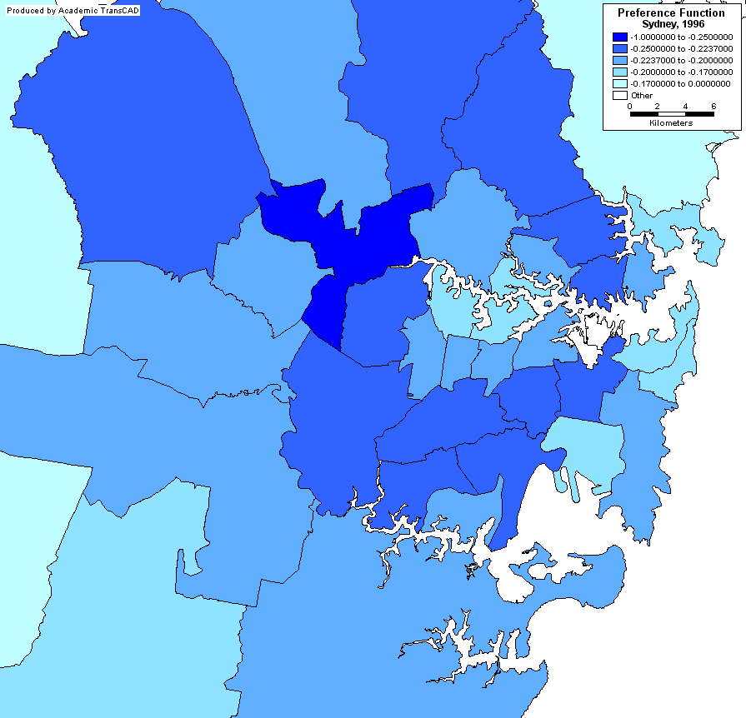


Travel Behavior
Sydney, Australia (1996)

Slide 10
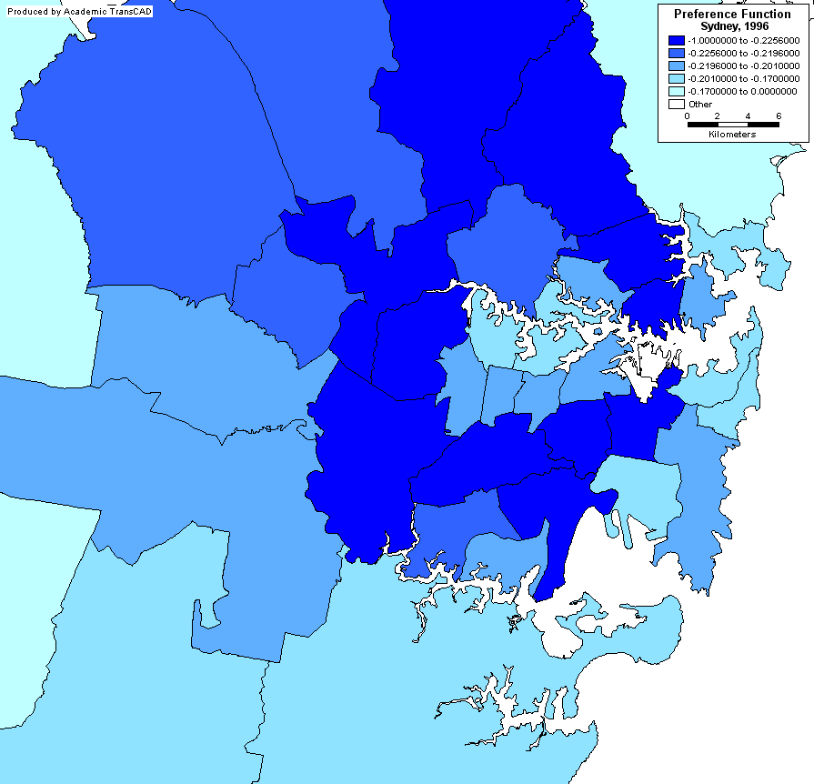
Travel Behavior in Sydney

Slide 11
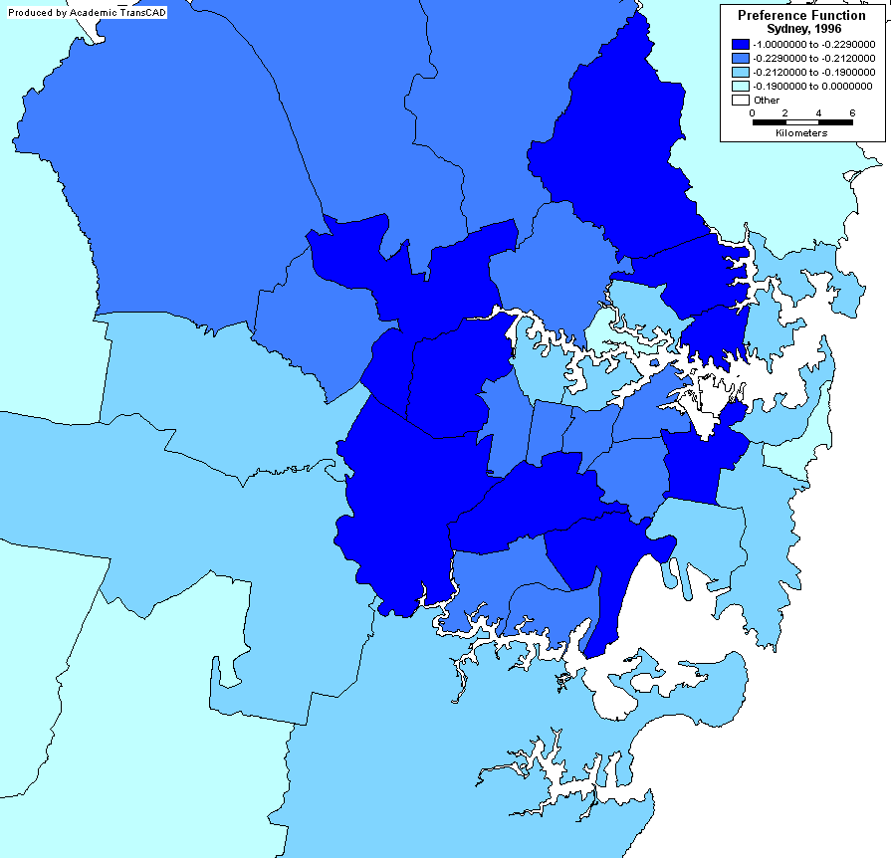
Travel Behavior in Sydney

Slide 12
Course Description
Spatial statistics
  Visualization
  Exploration
  Modeling
Course contents
  Point pattern analysis
  Spatially continuous data
  Area data

Slide 13
This session:
Course Outline
  Course objectives
  Evaluation
  Readings
  Guidelines and regulations
  Structure of weekly sessions and labs

Slide 14
Course Objectives
Describe and discuss the connections between ordinary statistics and the basic concepts in spatial statistics
Analyze geographical data by using of a variety of basic spatial statistical methods
Describe and discuss statistical results obtained by using methods of spatial statistics
Develop expertise in using the S-PLUS computer software package and its Spatial Statistics module

Slide 15
Readings
Spatial Data Analysis:
  Bailey, T.C. and A.C. Gatrell (1995) Interactive Spatial Data Analysis, Longman Group Limited.
Statistics in Geography:
  McGrew, J.C. and C.B. Monroe (1993) An Introduction to Statistical Problem Solving in Geography, W.M.C. Brown Publishers.

Slide 16
Course Evaluation
Evaluation scheme:
Assignments (4): | 40%
Mid-term exam | 20%
Final exam | 40%
Total | 100%
All students are reminded of the seriousness of Academic Dishonesty.
http://www.mcmaster.ca/senate/academic/ac_integrity.htm

Slide 17
Course Guidelines and Regulations
Contacting the instructors:
  Office hours
  E-mail
  Phone to set an appointment
  Questions:
    Theory and methods: Antonio Páez
    Technical questions (GIS, S-PLUS, etc.): Pat DeLuca

Slide 18
Organization of Course
Lectures
  Theories and methods
Labs
  Hands-on practice
    ArcView
    S-PLUS

Slide 19
Lectures and other events
Schedule: lectures and other events
DATE | TOPIC
September 18 | Lectures start – Course Outline, introduction and Part I
September 25 | Lecture (Part I) + Laboratory Orientation
October 2 | Laboratory Session
October 9 | Lecture (Part II+III). Assignment 1 Due.
October 16 | Lecture (Part III) + Laboratory Session
October 23 | Lecture (Part IV)
October 30 | Mid-term Examination + Laboratory Session. Assignment 2 Due
November 6 | Lecture (Part IV) + Laboratory Session
November 13 | Lecture (Part V)
November 20 | Laboratory Session. Assignment 3 Due.
November 27 | Lecture (Part V) + Laboratory Session
December 4 | Final Examination + Assignment 4 Due

Slide 20
Syllabus
Introduction
Part I: Descriptive Statistics
Part II: Spatial vs. Aspatial Data
Part III: Point Pattern Analysis
Part IV: Spatially Continuous Data
Part V: Area Data

Slide 21
Syllabus
Part I: Descriptive Statistics (Knowledge Assumed)
  Data and variables
  Processes
    Probabilistic
    Spatial
  Probability
  Graphical methods
    Histograms
    Frequency Distributions

Slide 22
Syllabus
Part I: Descriptive Statistics (Cont’d)
  Measures of central tendency
    Mean, Median, Mode
  Measures of dispersion
    Variance
  Probability Distributions
    Poisson Distribution
    Normal Distribution
    Joint Probability Distribution
  Covariance and Correlation
  Independent and Dependent Random Variables
  Inferential Statistics (Knowledge Assumed)

Slide 23
Syllabus
Part II: Spatial vs. Aspatial Data
  All data is spatial
  Space does not always enter the equation

Slide 24
Syllabus
Part III: Point Pattern Analysis
  Visualization
  Exploration
    First Order Properties
    Second Order Properties

Slide 25
Syllabus
Part III: Point Patterns

Slide 26
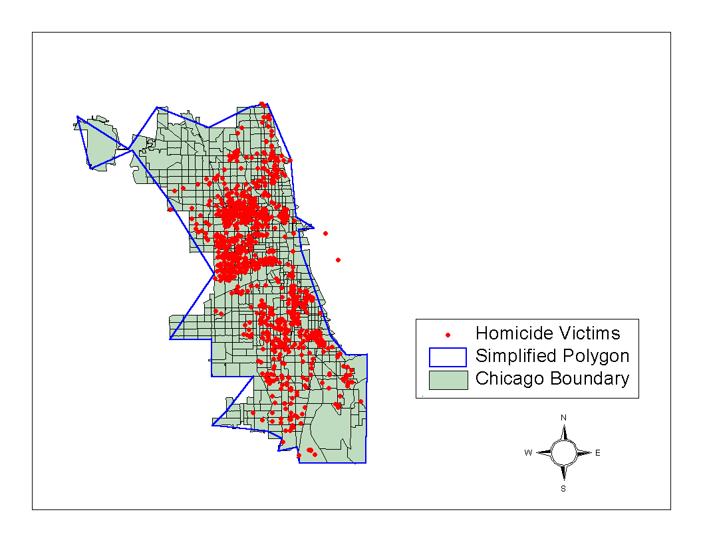
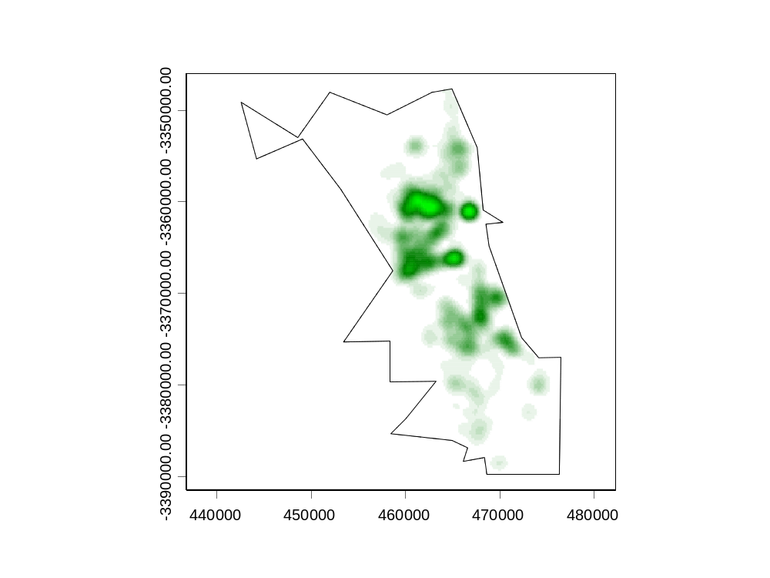
Syllabus
Part III: Point Patterns

Slide 27
Syllabus
Part IV: Spatially Continuous Data
  Visualization
  Exploration
    First Order Properties
    Second Order Properties

Slide 28
Syllabus
Spatially Continuous Data

Slide 29
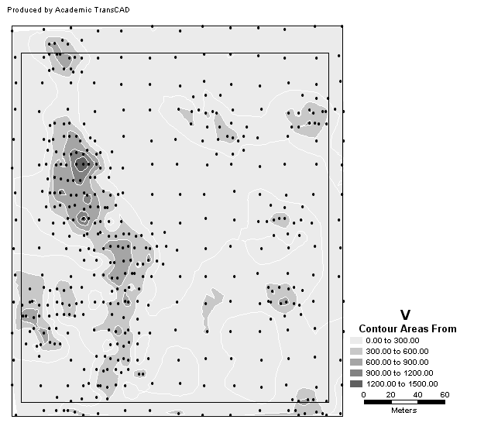
Syllabus
Spatially Continuous Data

Slide 30
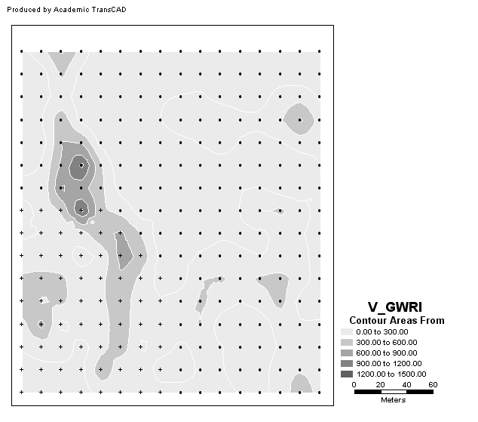
Syllabus
Spatially Continuous Data

Slide 31
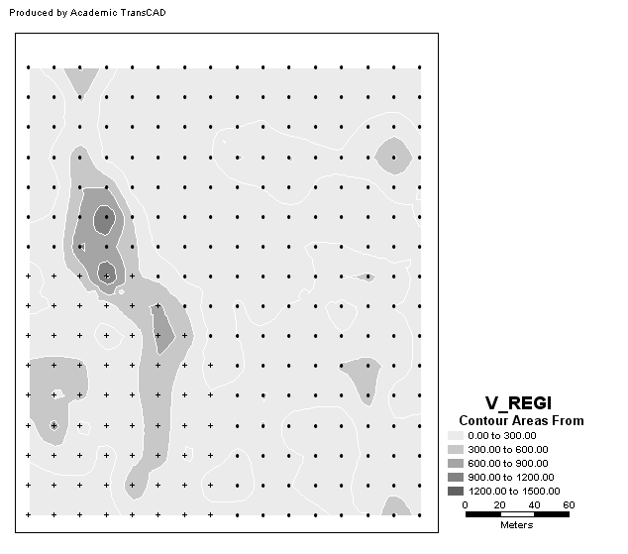
Syllabus
Spatially Continuous Data

Slide 32
Syllabus
Part V: Area Data
  Visualization
  Exploration
    First Order Variation
    Second Order Variation

Slide 33
Syllabus
Area Data

Slide 34
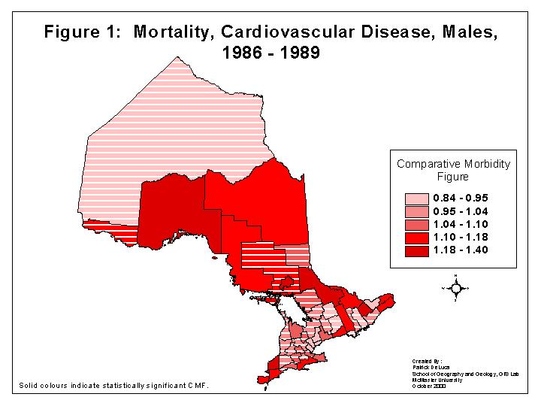
Syllabus
Area Data

Slide 35
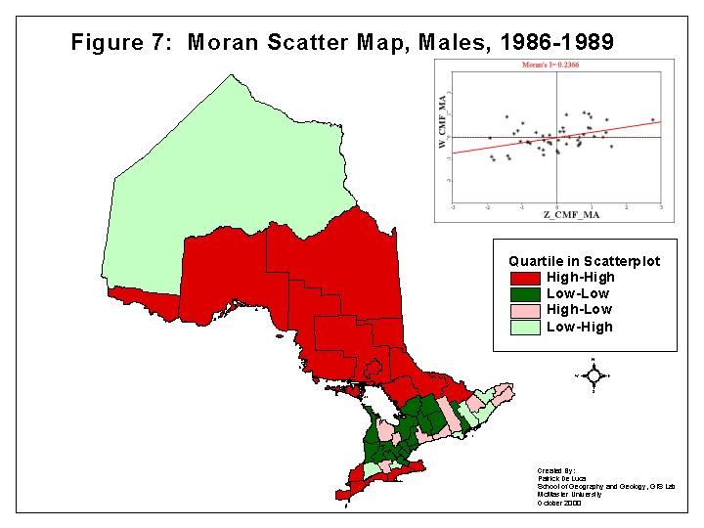
Syllabus
Area Data

Slide 36
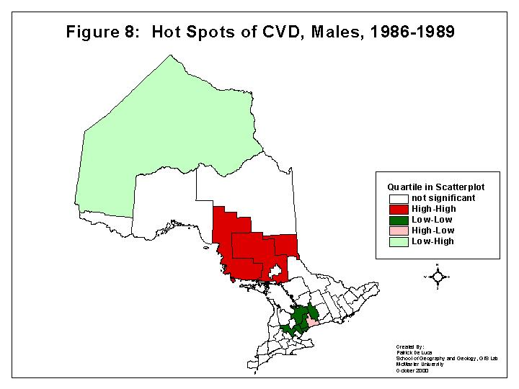
Syllabus
Area Data

Slide 37
What is LearnLink?
Is a web based course management system to deliver a course or components of it on-line.
Includes tools for facilitating learning, collaboration and communication
Content building utilities for organizing course materials

Slide 38
Why LearnLink?
Encourages self-directed and active learning
Encourages student-student contact
Gives timely feedback

